Slide 1





Rezidenc
SOLUTIONS FOR ROOMMATES

Slide 2
40 Million
13 Million Under 35
Roomates
Notes:
Key points:
Targeting Young Renters
Targeting Property Owners/Management
Market Size:
According to PEW research as of 2017 16% of American adults live in house share situations
This is over 40 million Americans
At $10 a month this could potentially be billions in revenue
2.5 Million Students in California
Age Breakdown of our target market:
55+ (30%)
45 to 54 (15.6%)
35 to 44 (19.9%)
under 35 (34.5%)

Slide 3



Our Target Market
Notes:
Duane Guerrero
Student at Sacramento State University. Likes to go to old town to have drinks with his friends and hang out often.
------------------------------------
Brigitte Schwartz
A nurse at a hospital. She likes to take care of plants and read. Unfortunately she's naturally messy.
------------------------------------
Preston Webster
A student at Sacramento State University and worker at Spicy Taco Palace and spends little time at home.
-------------------------------
Problems that our residents have together:
-----------------------------
- Schedules don't align
- Hard to make rent on time
- No dedicated communication tools for residents
- Hard to keep track of important documents
- Hard to keep track of all the shared expenses
- Hard to find tools to mediate arguments
- Hard to find new roommates that mesh well
Key Highlight
- Without a way to communicate or track roommate needs, these problems can pile up leading to conflict

Slide 4
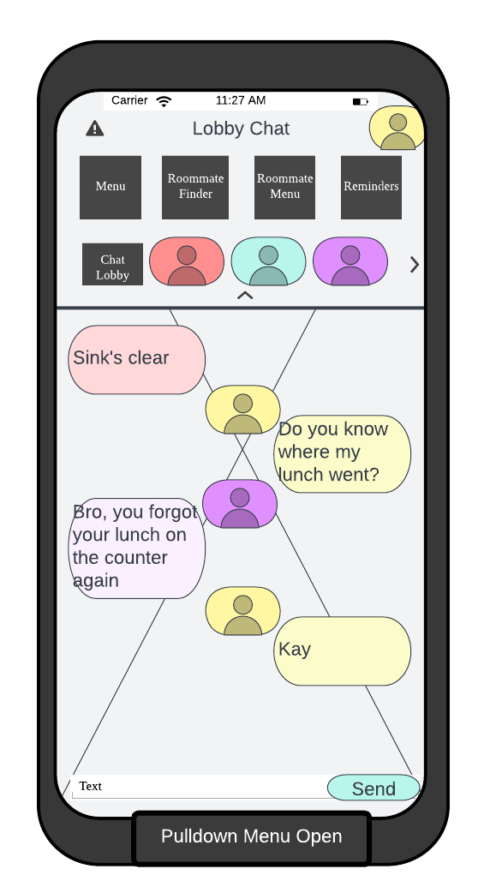

Rezidec
Notes:
Picture is a sample of app in development - not final product
Key features of rezidenc
-Chat
-Conflict Management
-Reminders
-Document Storage
-Roommate Finder
-Calendars
-Roommate management
How Rezidenc will help:
- Roommates can work together on chores using to-do lists. Provides accountability
- Group activity section to plan hangouts and outings for roommate wellbeing
- Collaborates with mental health providers for access to outside support
- Communicate directly with property management and property owners about issues

Slide 5





Business Model
B2B
Premium
B2C
Freemium
Notes:
Renters are the product to the property owners and management
Renters have the option to use the app for free
Additional features are available to residents who pay
Free Users Get
-Sheduling services
-Group messaging
-Bill reminders
-Group activity portal
Paid Users Also Get:
-Document Storage
-Budgeting
-Calendar
-Roomate rating

